Slide 1
Health Care
Arkaprabha Majumdar
(2018msbda015)
CURAJ, Ajmer

Slide 2
Diabetes
complicated disease characterized by either lack of insulin or a resistance to insulin, a hormone which is crucial for metabolism of blood sugar
the pancreas produces insulin to help metabolize sugar in the blood and maintain blood glucose (sugar) levels within their normal range
Diabetics are unable to produce insulin or are resistant to insulin, and consequently cannot remove glucose from the bloodstream
Whether there is inadequate insulin or insulin resistance, glucose levels in the blood increase and cause severe health problems

Slide 3
Type - 1 vs Type - 2 ::
Type 1 | Type 2
an autoimmune dis- order in which the insulin producing beta cells are destroyed by the body’s immune system (aka Juvenile Diabetes) | insulin is produced in insufficient amounts and/or cannot be used by the body to control blood sugar levels (aka Adult Diabetes)

Slide 4
Q. To detect Diabetes so that we can take necessary precautions.
To design automatic diagnosis system for diabetes on the basis of fuzzy modeling method to detect medical problems which relies on discovering human comprehensible knowledge

Slide 5
Diabetes disease database
The Pima Indians Diabetes database that we have used is provided from the UCI (University of California Irvine) repository of machine learning
This database contains 768 patterns with 8 features that belong to two classes (Not Diabetic, Diabetic)
The 8 features are: Number of times pregnant, Plasma glucose concentration, Diastolic blood pressure, Triceps skin fold thickness, Insulin, Body mass index, Diabetes pedigree function, Age

Slide 6
A brief introduction of Fuzzy Sets:
Membership function (MF) - A function that specifies the degree to which a given input belongs to a set.
Membership functions are used in the fuzzification and defuzzification steps of a FLS (fuzzy logic system), to map the non-fuzzy input values to fuzzy linguistic terms and vice versa.
A membership function (MF) is a curve that defines how each point in the input space is mapped to a membership value (or degree of membership) between 0 and 1.

Slide 7
There are different forms of membership functions such as:
Triangular
Trapezoidal
Gaussian.
membership function must vary between 0 and 1.

Slide 8
Triangle(x; a, b, c) = 0 if x <a;
= (x-a)/(b-a) if a <= x <b;
= (c-x)/(c-b) if b <=x <c;
= 0 if c <=x.
Trapezoidal(x; a, b, c, d) = 0 if x a;
= (x-a)/(b-a) if a x b;
= 1 if b x c;
= (d-x)/(d-c) if c x d;
= 0, if d x.

Slide 9
Types of Fuzzy Inference Systems
Mamdani
Sugeno
Tsukamoto
Difference is in consequents of fuzzy rules and their aggregation and defuzzification process.

Slide 10
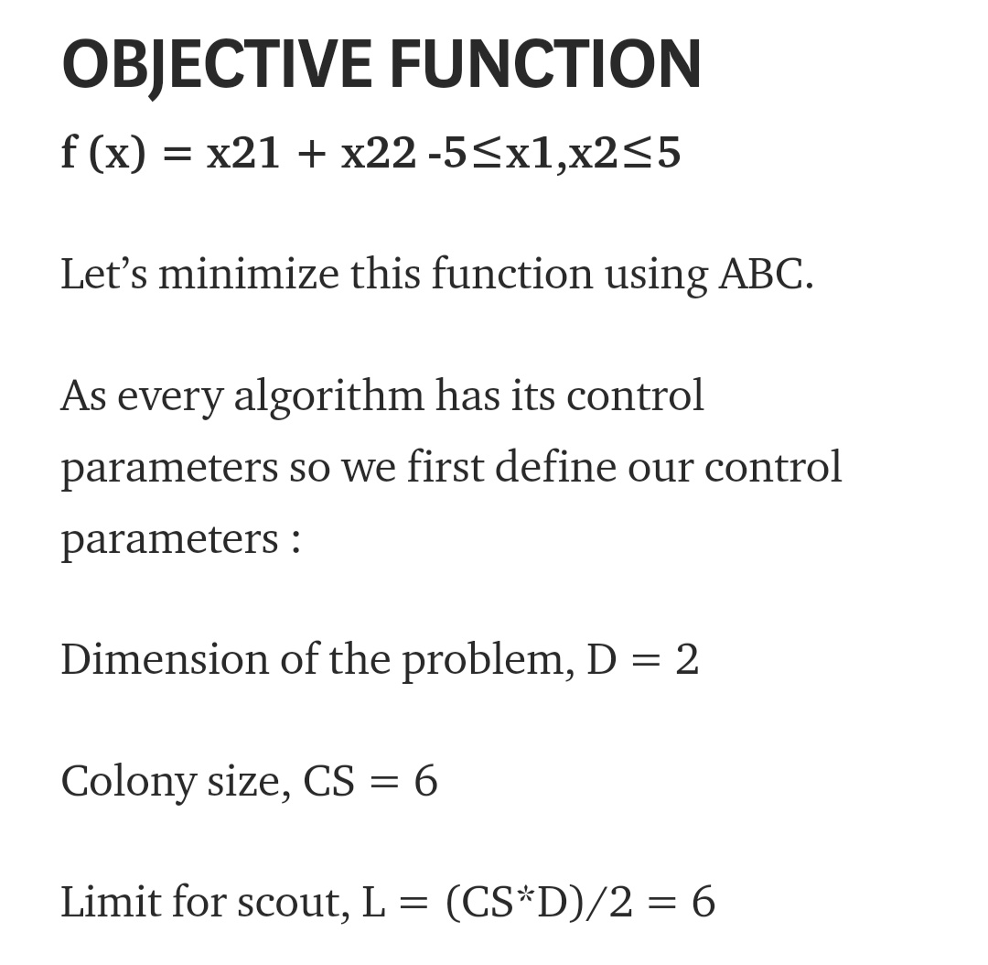

Slide 11
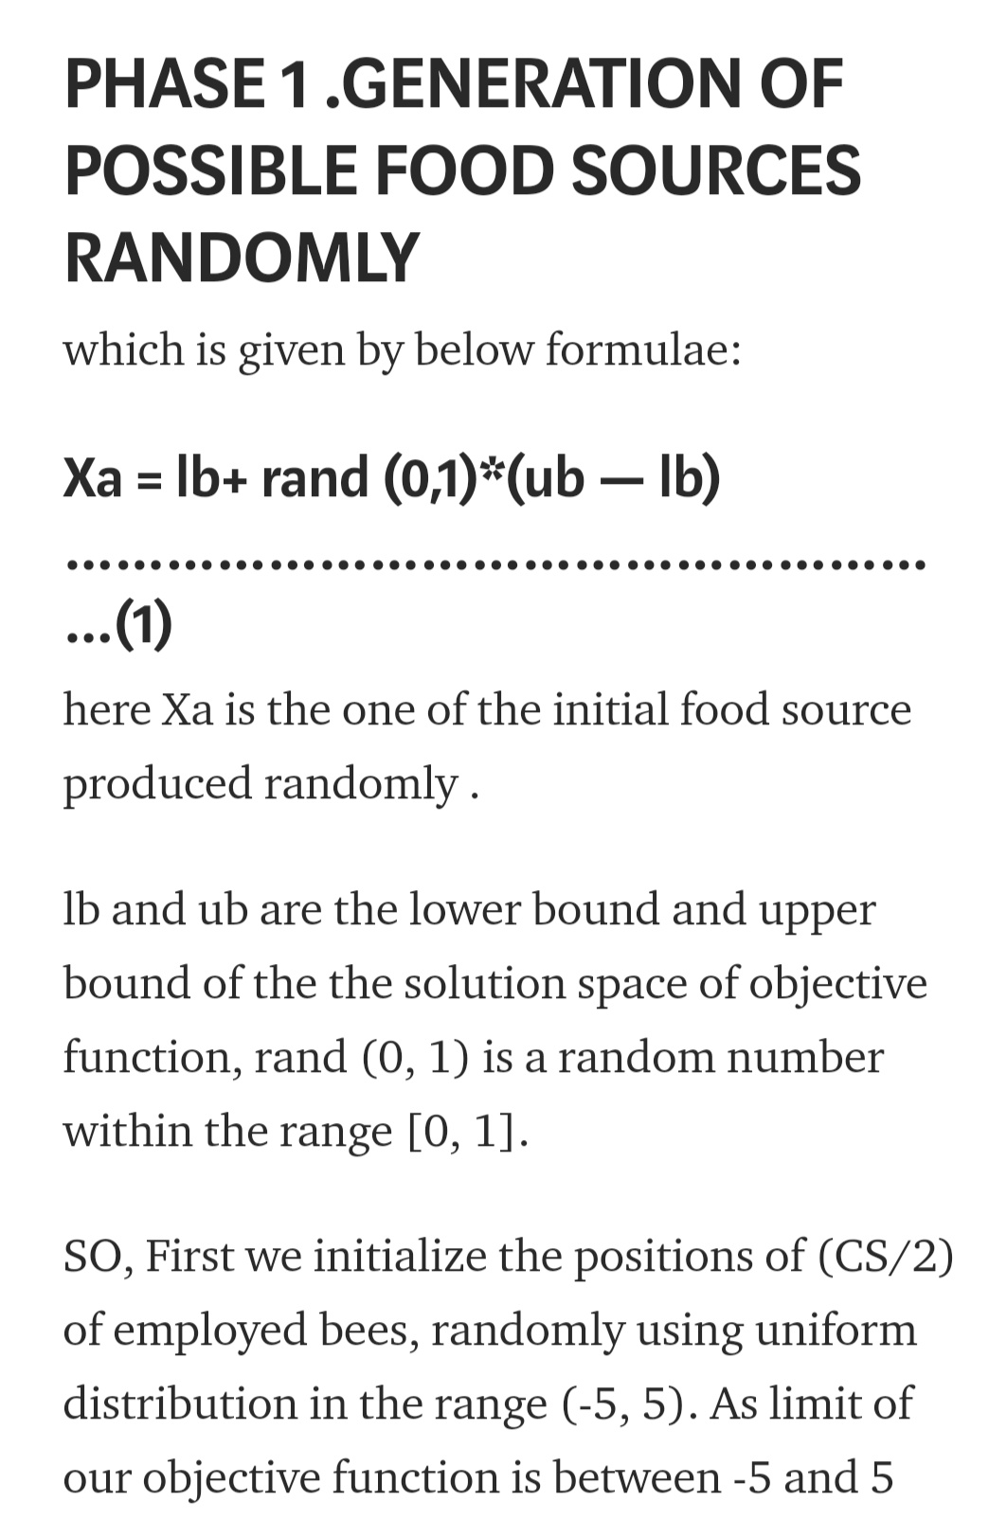

Slide 12
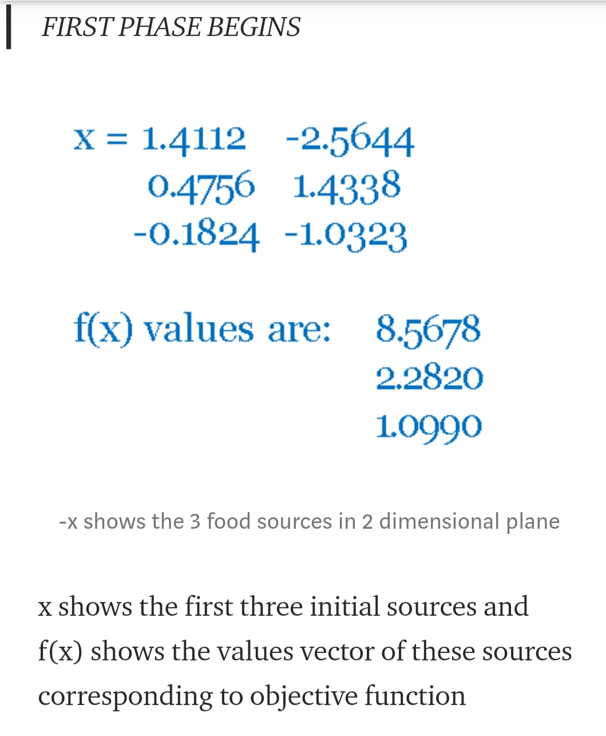

Slide 13
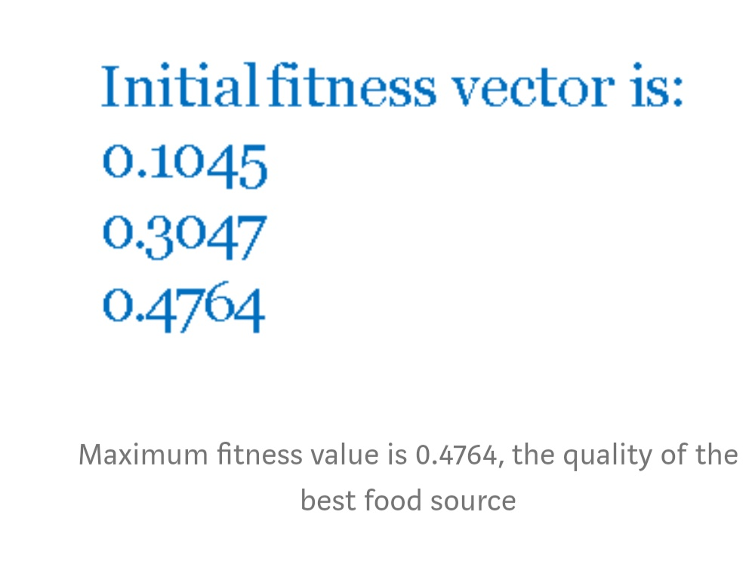

Slide 14
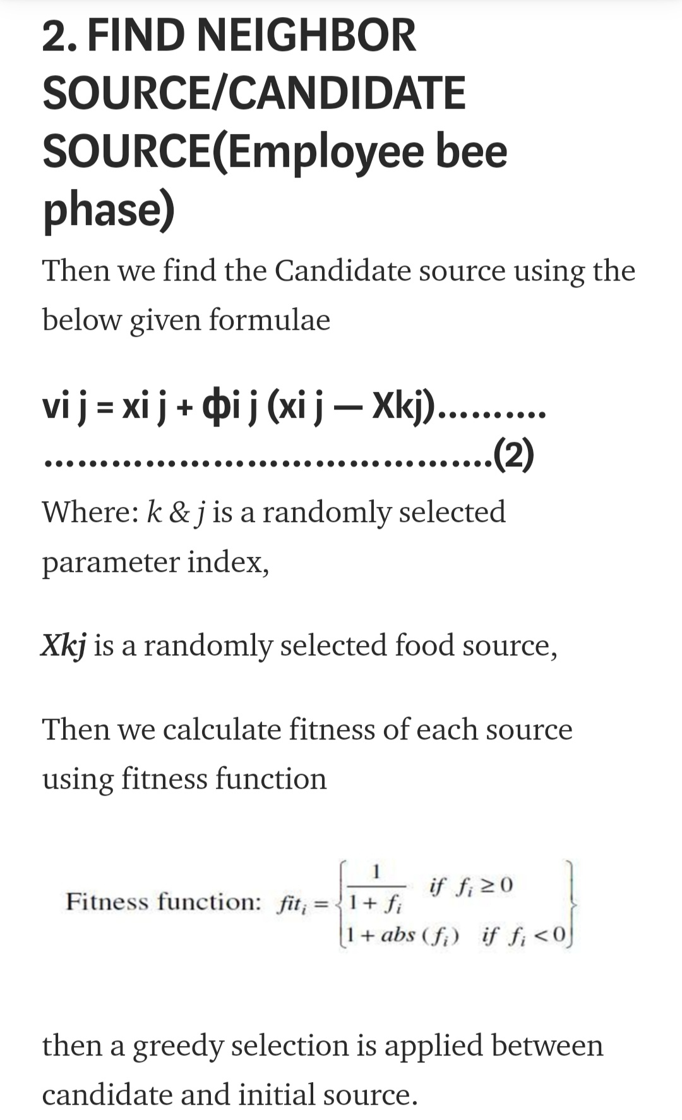

Slide 15
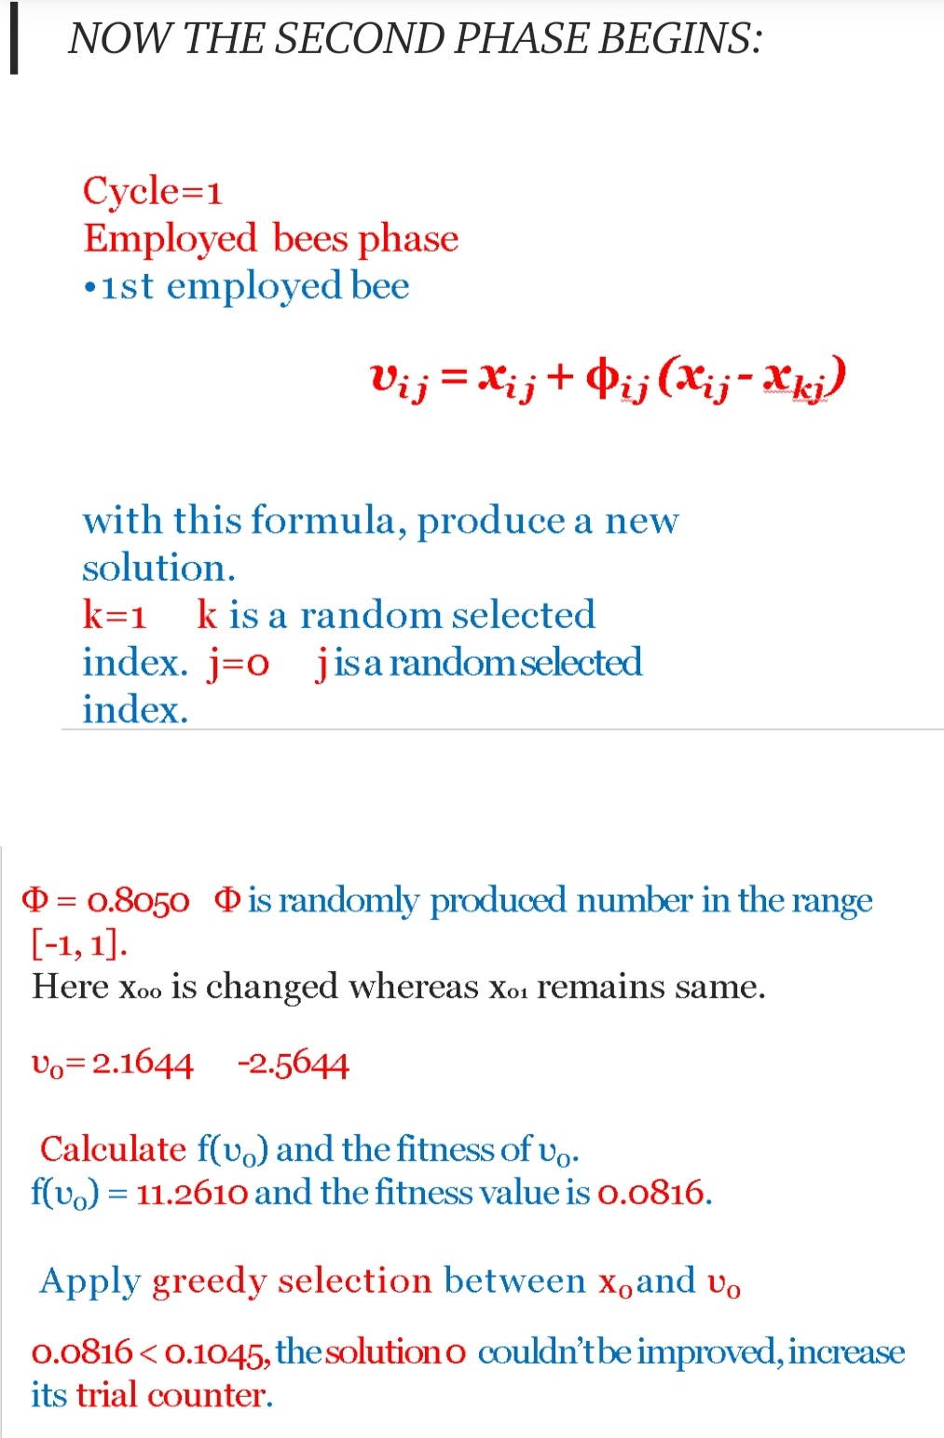

Slide 16
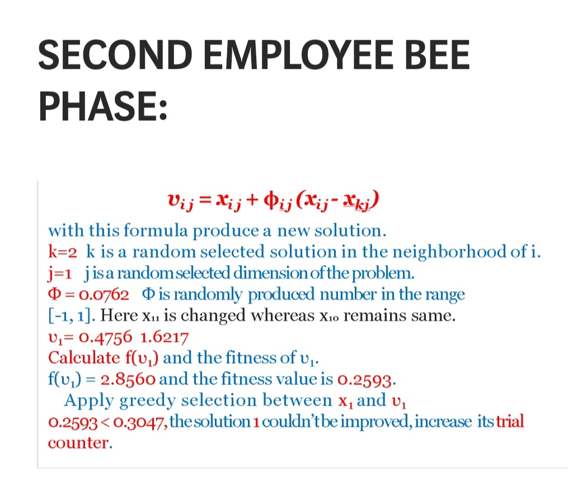

Slide 17
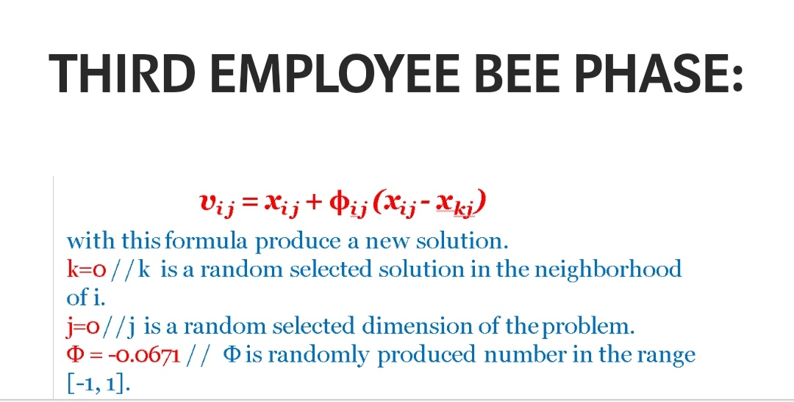

Slide 18
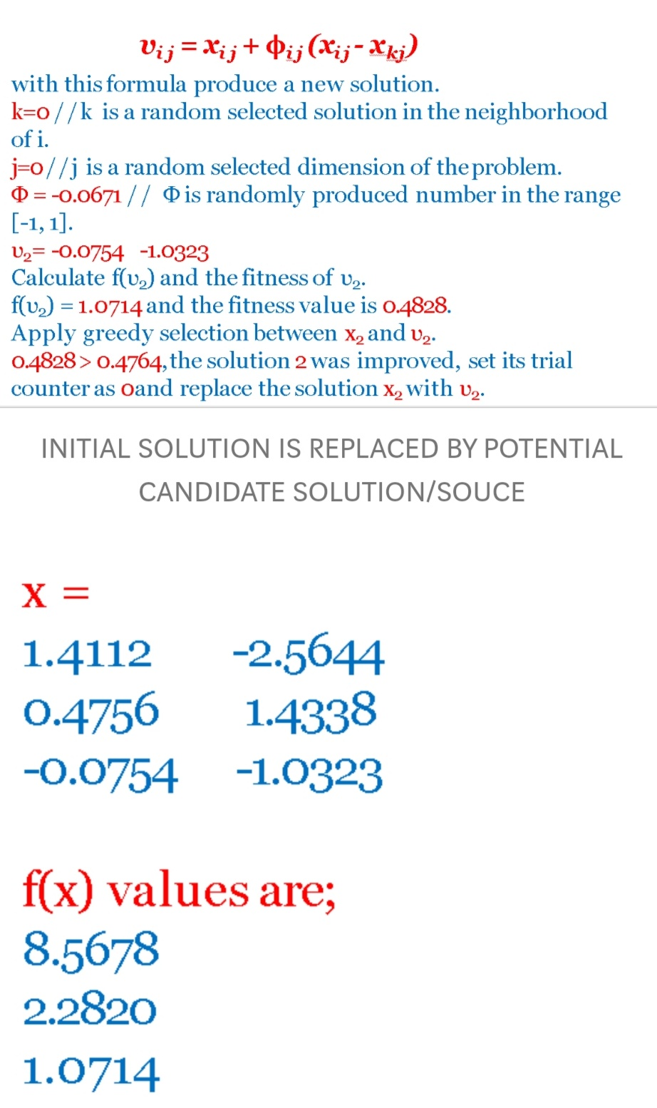

Slide 19
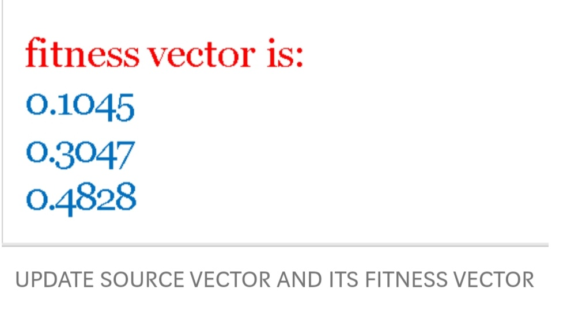

Slide 20
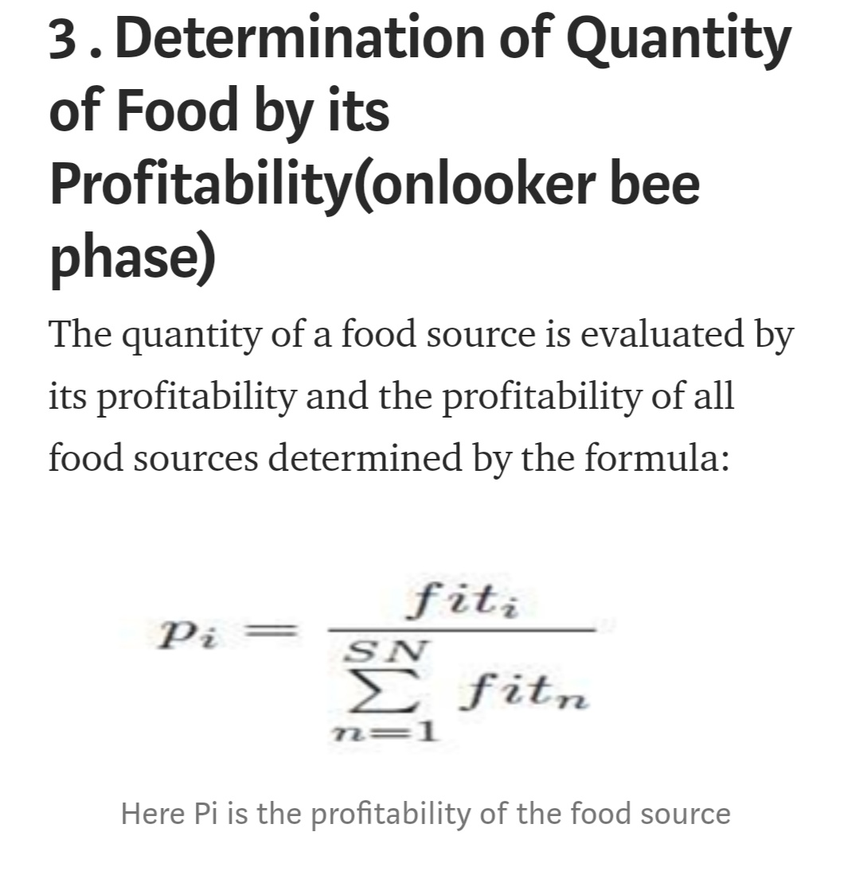

Slide 21
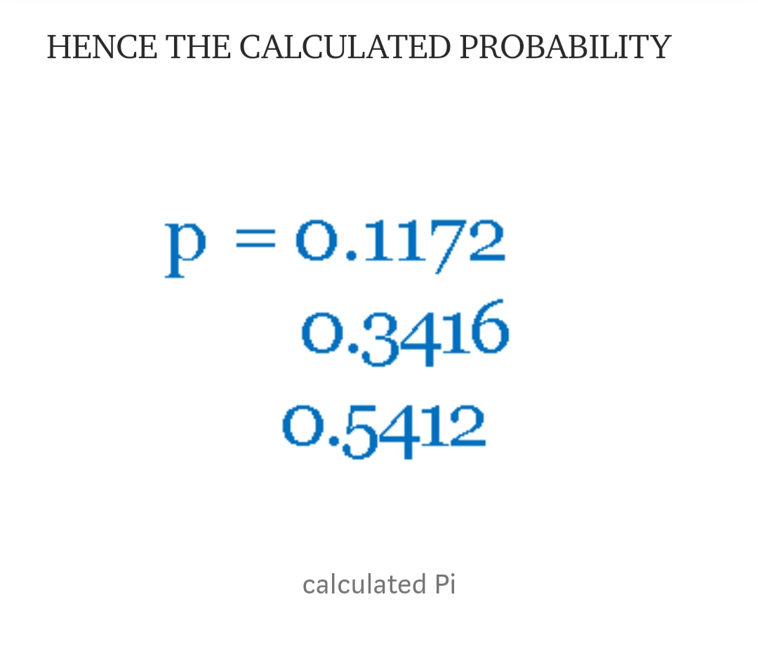

Slide 22
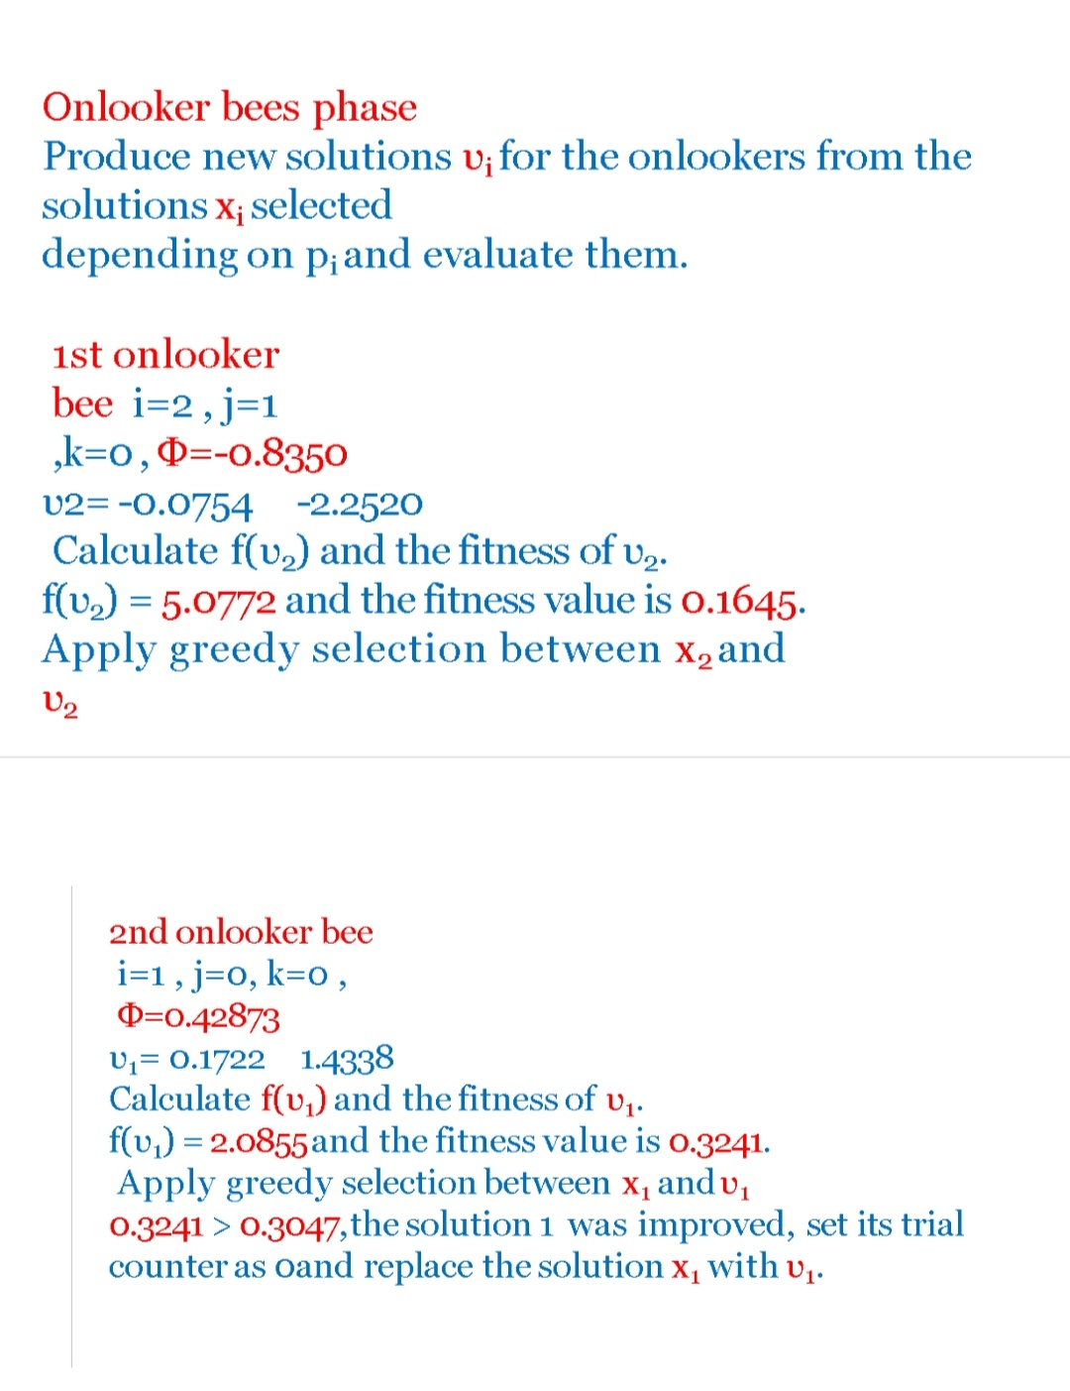

Slide 23
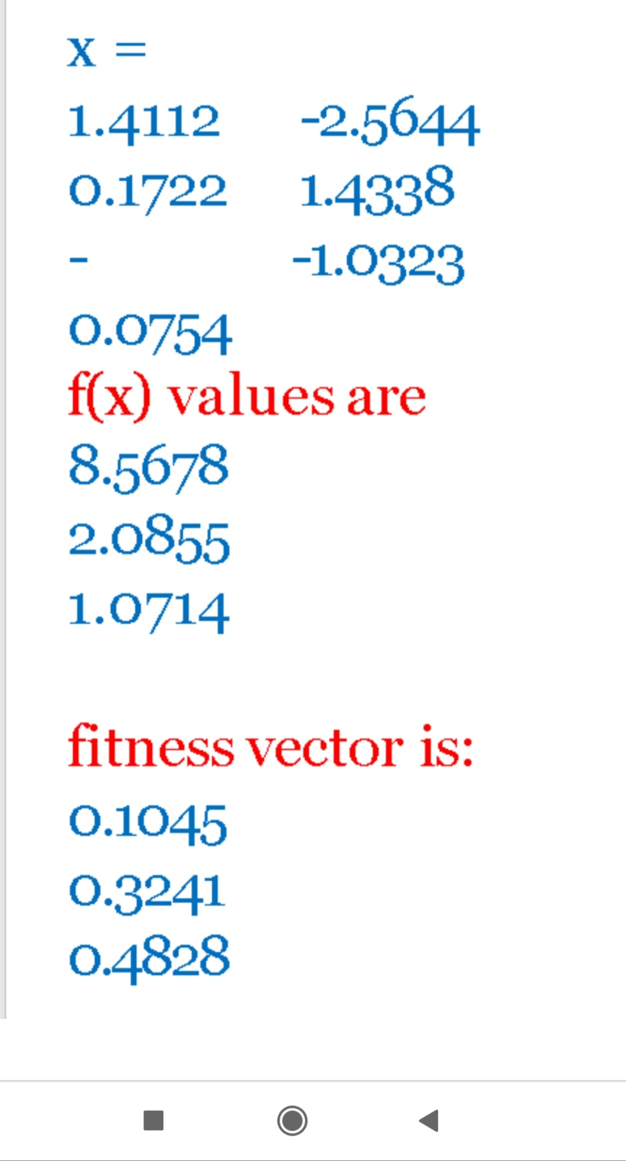

Slide 24
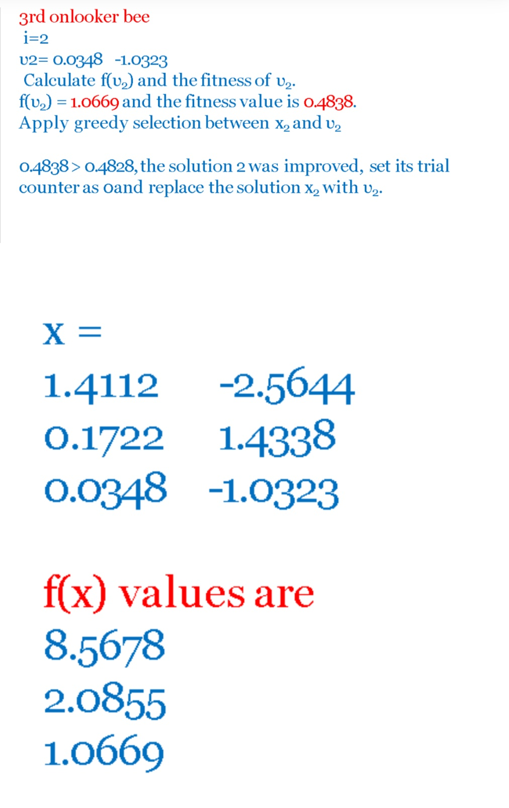

Slide 25
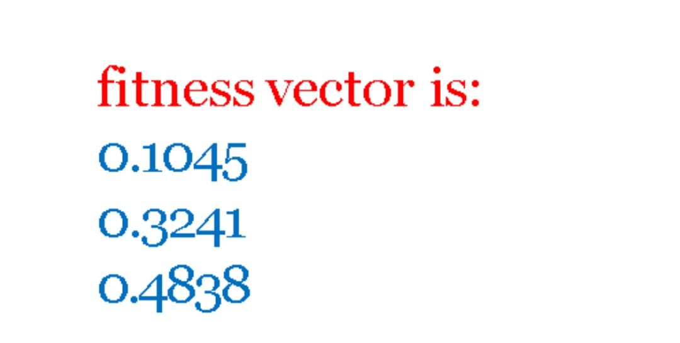

Slide 26
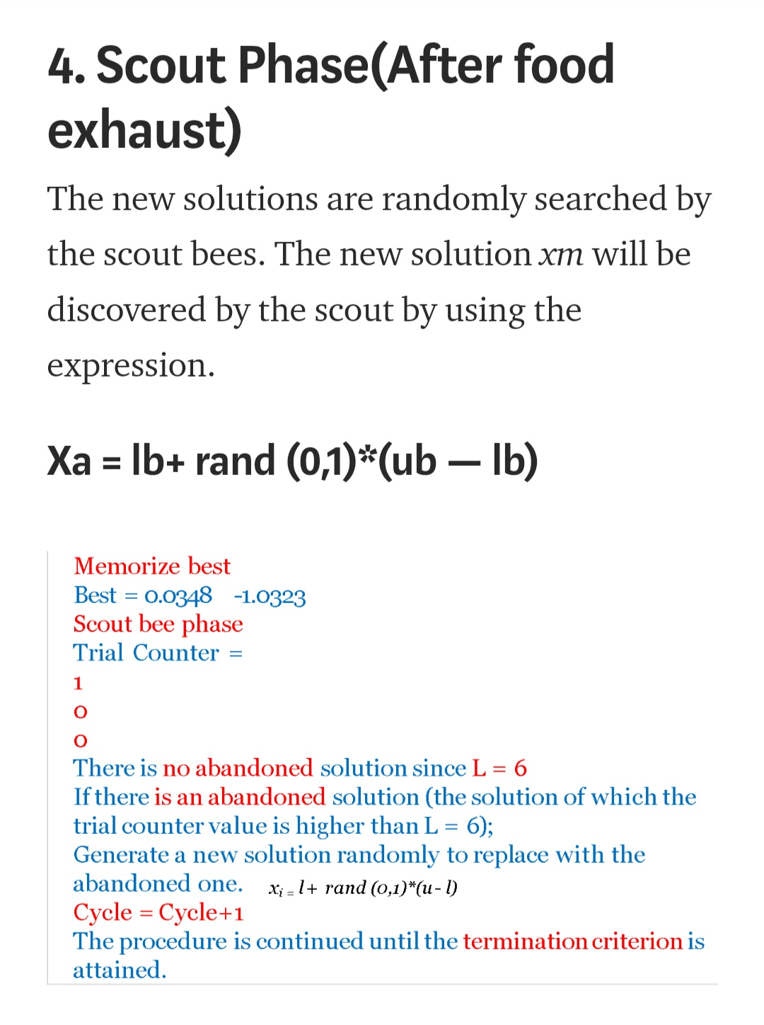

Slide 27
FRBCS

Slide 28
Fuzzy rules based classification model
consists of linguistic rules which are easy to interpret by the user
The classification problem consists of m training patterns X p (x p1 , . . .,x pn )(p = 1,2, . . .,m) from M classes where x pi is the ith attribute value (i = 1, 2, . . .,n) of the pth training pattern
the fuzzy “if-then” rules can be expressed as follows:
R j : if xp1 is A j1 and xp2 is Aj2 and. . .and xpn is Ajn
THEN xp(xp1 , . . . , xpn ) belongs to class Cj = 1, . . . , N

Slide 29
R j is the label of the jth rule
X = (x 1 , . . .,x n ) is an n-dimensional pattern vector
A ji is an antecedent fuzzy set
C (c = 1, 2, . . .,M) is a class label
The single winner rule Rw is determined for a new pattern xp (xp1 , . . .,xpn ) as:
w = argmax{ j (x p )} |j = 1, 2, . . . , N|
uj (Xp ) is the degree of compatibility grade of the pattern Xp with the antecedent fuzzy set Aj (Aj1 , Aj2 , . . ., Ani ) of the rule Rj

Slide 30
trade-off between the accuracy and the interpretability of the model.
FRBCS is composed of three main components: database, rule-base and reasoning method.
The database contains the fuzzy set definitions related to the linguistic terms used in the fuzzy rules.
The rule base consists of a set of fuzzy if-then rules in the form of "if a set of conditions are satisfied, then a set of consequences can be inferred".
Reasoning method uses information from database and rule-base to determine a class label for patterns and to classify them.

Slide 31
Our pattern classification problem is a n-dimensional problem with
C classes and
m training patterns, Xp = [xp1, xp2… xpn], p = 1, 2 ...m.
Usually, each attribute of the given training patterns is normalized into a unit interval [0, 1] by using a linear transformation that preserves the distribution of training patterns.

Slide 32
Sugeno-Weber TNorm ::
Max { (x+y -1 + alpha*x*y) / (1+ alpha) }

Slide 33
a =x 1 − ̨(x 2 − x 1 )
b = x 2 − ̨(x 2 − x 1 )
Y = a + r ∗ (b − a) : ifx min ≤ Y ≤ x max
(else repeat generation)
Where r: random number in [0,1]
if there is no improvement in fitness function
in the employed or onlooker stage, the positions are mutated using blended crossover operator.

Slide 34
The rules with all features
R1: If (Npreg is H) and (Glu is L) and (BP is H) and (Skin is L) and (Insulin is L) and (BMI is H) and (PED is H) and (Age is L) then (Class is Non-diabetic)
R2: If (Npreg is L) and (Glu is L) and (BP is L) and (Skin is L) and (Insulin is L) and (BMI is L) and (PED is H) and (Age is L) then (Class is Non-diabetic)
R3: If (Npreg is H) and (Glu is L) and (BP is H) and (Skin is L) and (Insulin is L) and (BMI is H) and (PED is L) and (Age is L) then (Class is Non-diabetic)
R4: If (Npreg is L) and (Glu is L) and (BP is L) and (Skin is H) and (Insulin is L) and (BMI is L) and (PED is L) and (Age is L) then (Class is Non-diabetic)
And so on...

Slide 35
Experimental results have shown that the proposed approach with Fuzzy-ABC is simple and effective in explaining the interpretability of fuzzy classifier by reducing the 256 rules to an average of 12.2 efficient rules when using all attribute and an average of 7.1 efficient rules using features selection while preserving the model accuracy at a satisfactory level.

